Slide 1
Microsoft Excel 2013
Dr. Wameedh. T.M. Al-Tameemi

Slide 2
Excel 2013 Formulas
Formula structure
Generally, functions contain 4 parts after the equal sign:
Function name;
Opening parenthesis;
A series of arguments separated by commas; and
Closing parenthesis.

Slide 3
Excel 2013 Formulas
Function library

Slide 4
Excel 2013 Formulas
Function library

Slide 5
Excel 2013 Formulas
Excel for Architects
1. Using VLOOKUP
VLOOKUP is easily one of Excel’s most useful functions. VLOOKUP lets Excel function more like a database than just a spreadsheet. It lets you search for a value in another location such as another series of cells or another worksheet in the Excel file. If Excel finds that value, it displays other information associated with the value
Step 1 – Create a new worksheet
Start by creating a new Excel file. By default, Excel creates a single workbook titled “Sheet1”. Clicking the “+” icon next to the sheet tab (located at the bottom of the screen) creates a new worksheet.
Step 2 – Rename worksheets
Rename “Sheet1” as “Door Schedule” and “Sheet2” as “Door Types”. These are the two worksheets we’ll work with for this example.

Slide 6
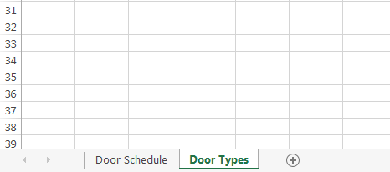
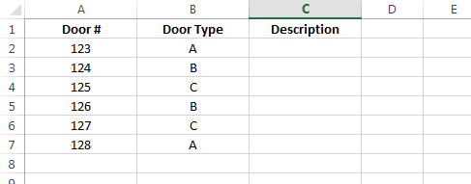
Excel 2013 Formulas
Step 3 – Add doors
In the “Door Schedule” worksheet, create columns for “Door #”, “Door Type” and “Description”. Add the follow data to the worksheet:

Slide 7
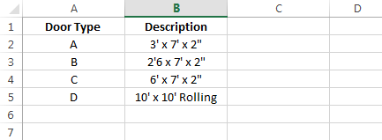
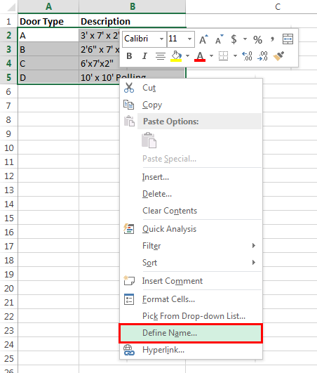
Excel 2013 Formulas
Step 4 – Add door types
Switch over to the “Door Types” worksheet and add the following data:
Step 5 – Create named range
Named ranges make it easy to refer to specific cells in a worksheet. To create a named range for the door types, start by highlighting the door types (but not the column headers) in the worksheet. Right-click and select “Define name” from the menu. Enter “Doors” as the name. This will make it easier to refer to the door types in the VLOOKUP formula.

Slide 8
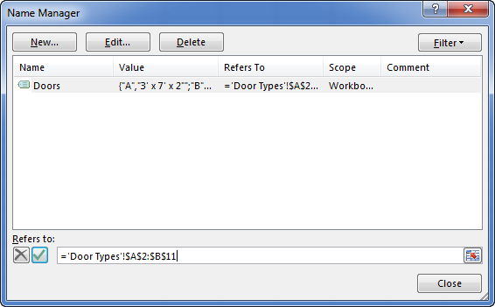
Excel 2013 Formulas
If you add additional door types at a later date, you will need to adjust the named range. Go to Formulas > Name Manager in the ribbon. Select the “Doors” name from the list and adjust the range in the “Refers to” section.

Slide 9
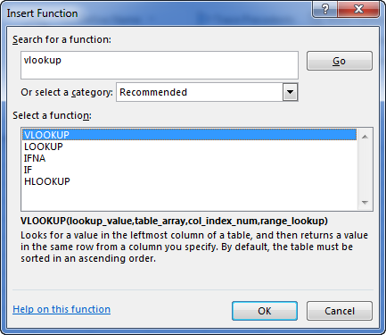
Excel 2013 Formulas
Step 6 – Insert function
We want to get the door description based on the door type. To do this, we’ll need to insert a formula using the VLOOKUP function. Click back to the “Door Schedule” worksheet. In the “Description” column for the first door, click Formulas > Insert Function from the ribbon. Type “VLOOKUP” in the search box, select it from the list and click the “OK” button.

Slide 10
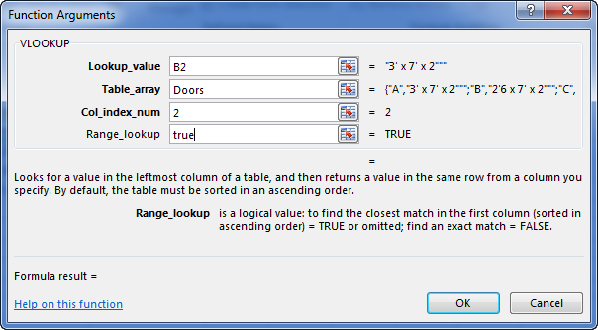
Excel 2013 Formulas
Step 7 – Format VLOOKUP
There are four fields you need to fill out for the VLOOKUP function:
Lookup_Value – The “key” value in the door schedule worksheet. In this example, type B2 (the current door type).
Table_array – The range of cells in the door type worksheet. In this example, type the named range “Doors”.
Col_index_num – The index of the column you want to display. In this example, we want to show the description information so enter “2” in the field.
Range_lookup – Enter “false” if you only want exact matches or “true” if the match can be close.
Click “OK” and Excel will display the description of door type A from the Door Types worksheet.

Slide 11
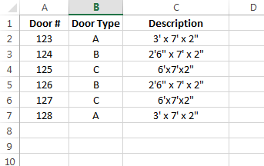
Excel 2013 Formulas
Step 8 – Copy formula
To apply this formula to the other doors in the door schedule worksheet, copy and paste the formula into the remaining description cells. The formula will pull each door’s description from the “Door Types” worksheet.

Slide 12
Excel 2013 Formulas
IF
It gives one of two different outcomes depending on whether a condition is satisfied or not.
=IF(Condition, “value if true ”, “value if false ”)
Parameters or Arguments
condition
The value that you want to test.
value_if_true
It is the value that is returned if condition evaluates to TRUE.
value_if_false
Optional. It is the value that is returned if condition evaluates to FALSE

Slide 13
Excel 2013 Formulas
SUMIF
Performs the SUM function only on instance that meet certain criteria. Use SUMIFS to specify multiple criteria.
=SUMIF( range, criteria, [sum_range] )
Parameters or Arguments
range
The range of cells that you want to apply the criteria against.
criteria
The criteria used to determine which cells to add.
sum_range
Optional. It is the range of cells to sum together. If this parameter is omitted, it uses range as the sum_range.

Slide 14
Excel 2013 Formulas
SUMIF
Performs the SUM function only on instance that meet certain criteria. Use SUMIFS to specify multiple criteria.
=SUMIF( range, criteria, [sum_range] )
Parameters or Arguments
range
The range of cells that you want to apply the criteria against.
criteria
The criteria used to determine which cells to add.
sum_range
Optional. It is the range of cells to sum together. If this parameter is omitted, it uses range as the sum_range.

Slide 15
Excel 2013 Formulas
ROUND
Rounds a number to a specified number of digits. Can also use ROUNDUP and ROUNDDOWN to specify the direction of rounding.
=ROUND(number;digits)
Parameters or Arguments
number
The number to round.
digits
The number of digits to round the number to.

Slide 16
Excel 2013 Next
Next lecture: Formulas-III
Thank you very much

